Slide 1
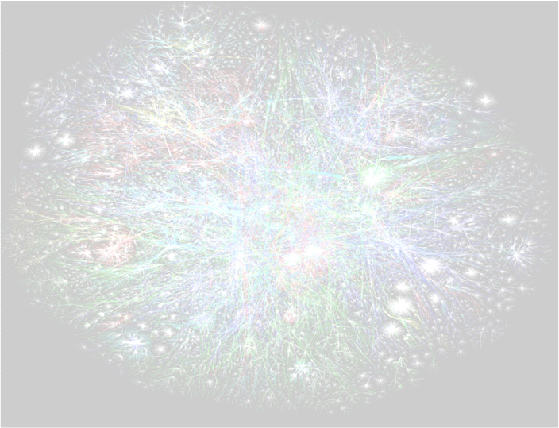
Discrete Mathematics and its Applications Lecture 1 – Graph Theory
AM8002
Dr. Anthony Bonato
Ryerson University

Slide 2
Course agreement
The goal of this course is to offer a meaningful, rigorous, and rewarding experience to every student; you will build that rich experience by devoting your strongest available effort to the class.
You will be challenged and supported.
Please be prepared to take an active, patient, and generous role in your own learning and that of your classmates. (c/o Federico Ardila)

Slide 3
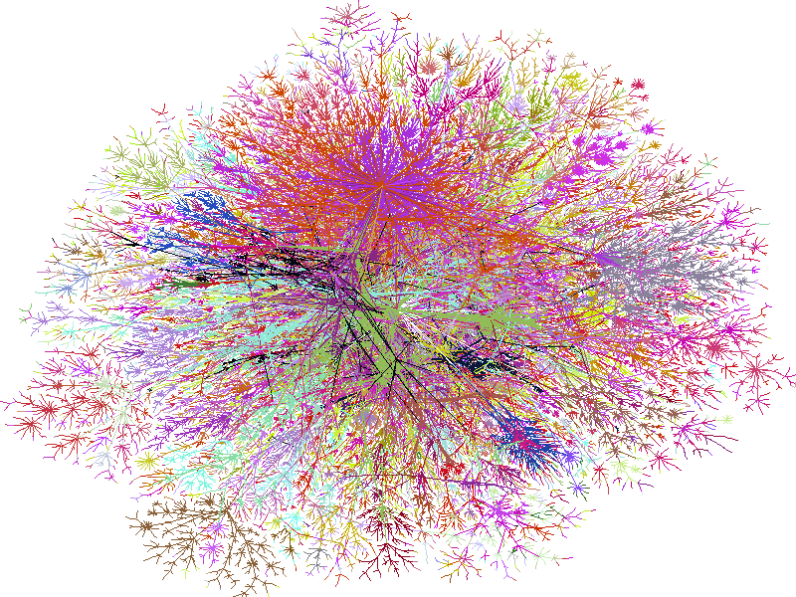
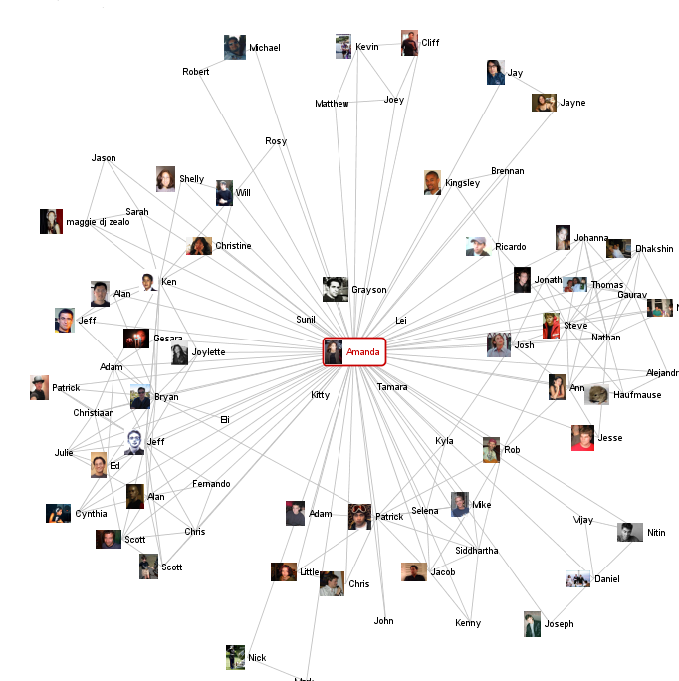
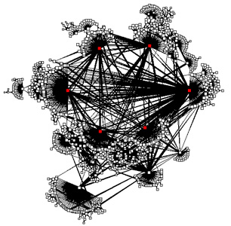
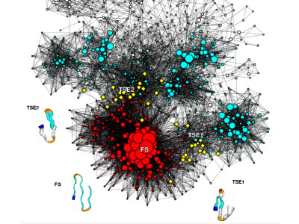
Graph theory in the era of Big Data
web graph, social networks, biological networks, internet networks, …

Slide 4
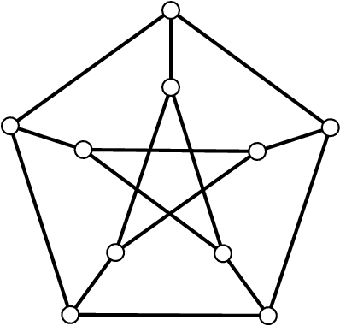
a graph G=(V(G),E(G))=(V,E)
consists of a nonempty set
of vertices or nodes V, and
a set of edges E, which is
a symmetric binary
relation on V
nodes
edges
in directed graphs (digraphs) E need not
be symmetric

Slide 5
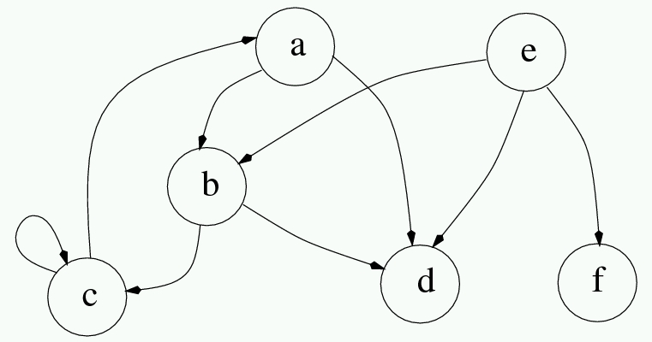
A directed graph

Slide 6
number of nodes: order, |V|
number of edges: size, |E|

Slide 7
Exercise
1.1. In a graph with no loops or multiple edges of order n, what is the maximum number of possible edges?
1.2 What is an example of a graph of order n with the maximum number of edges?

Slide 8
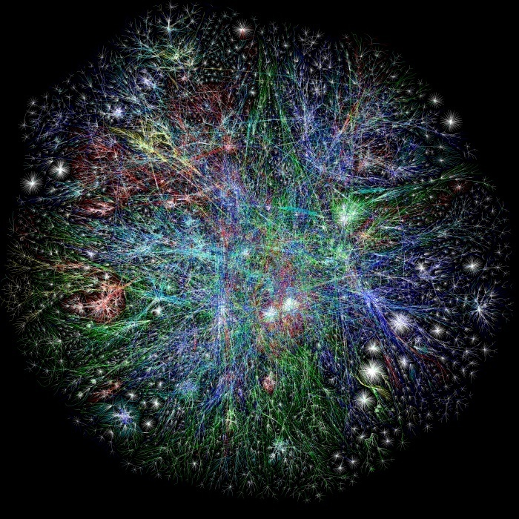
The web graph
nodes: web pages
edges: links
over 1 trillion nodes, with billions of nodes added each day

Slide 9
Nuit
Blanche
Ryerson
City of
Toronto
Four
Seasons
Hotel
Frommer’s
Greenland
Tourism
small world property

Slide 10
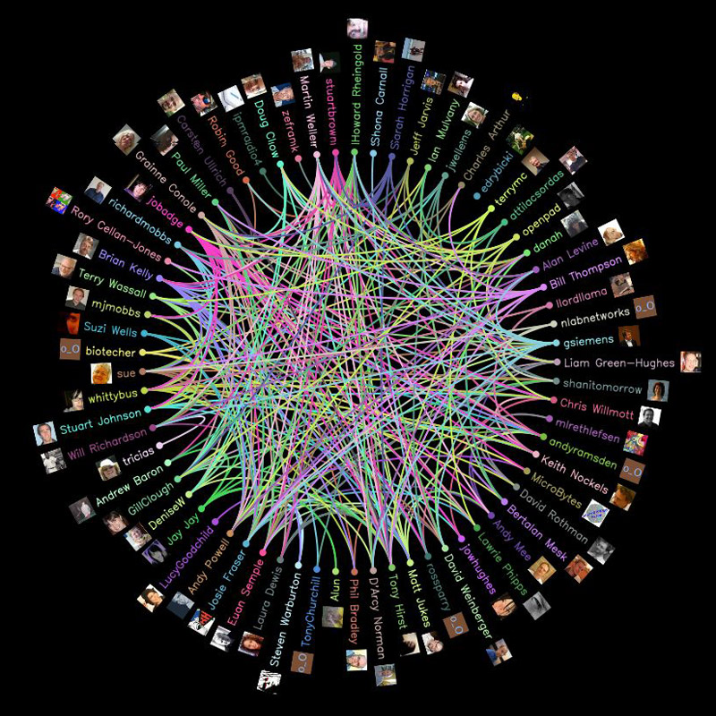
On-line Social Networks (OSNs) Facebook, Twitter, LinkedIn…

Slide 11
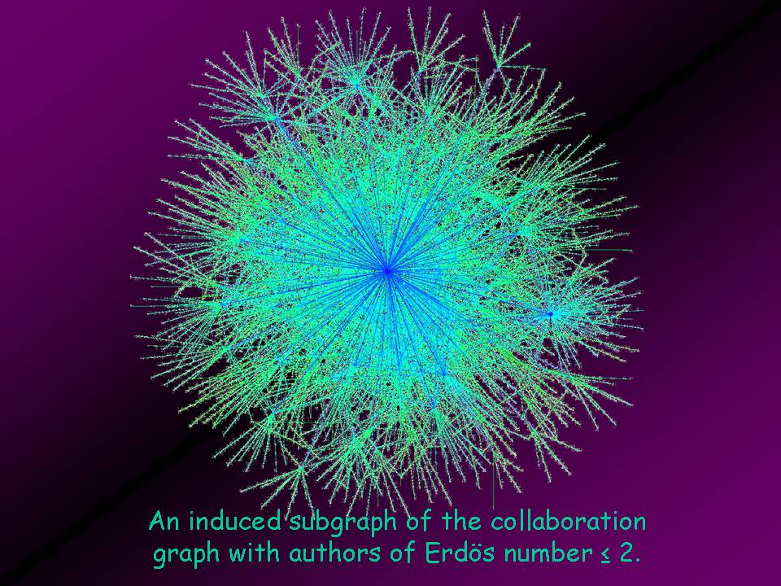

Slide 12
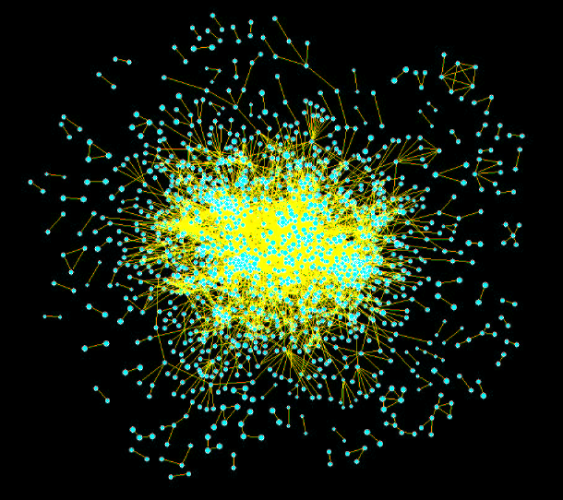
Biological networks: proteomics
nodes: proteins
edges:
biochemical interactions
Yeast:
2401 nodes
11000 edges

Slide 13
Complex networks
the web graph, OSNs, and protein interaction networks are examples of complex networks:
large scale
small world property
power law degree distributions

Slide 14
Degrees
the degree of a node x, written
deg(x)
is the number of edges incident with x
Theorem 1.1 - First Theorem of Graph Theory:

Slide 15
Corollary 1.2: In every graph, there are an even number of odd degree nodes.
for example, there is no order 19 graph
where each vertex has order 9 (i.e. 9-regular)

Slide 16
Exercise
1.3 Show that a graph cannot have each vertex of different degree.
(Hint: proof by contradiction!)

Slide 17
Subgraphs
let G be a graph, and S a subset of V(G)
the subgraph induced by S in G has vertices S, and edges those of G with both endpoints in S
written <S>_{G}
a subgraph is a subset of the vertices and edges of G
a spanning subgraph is a subgraph H with V(H)=V(G)

Slide 18
<S>_{G}
S

Slide 19
a spanning subgraph (tree)

Slide 20
Isomorphisms
let G and H be graphs, and let f: V(G)→V(H) be a function
f is a homomorphism if whenever xy is an edge in G, then f(x)f(y) is an edge in H;
write: G → H
f is an embedding if it is injective, and xy is an edge in G iff f(x)f(y) is an edge in H
write: G ≤ H
f is an isomorphism iff it is a surjective embedding
Write:
NOTE: isomorphic graphs are viewed as the “same”

Slide 21
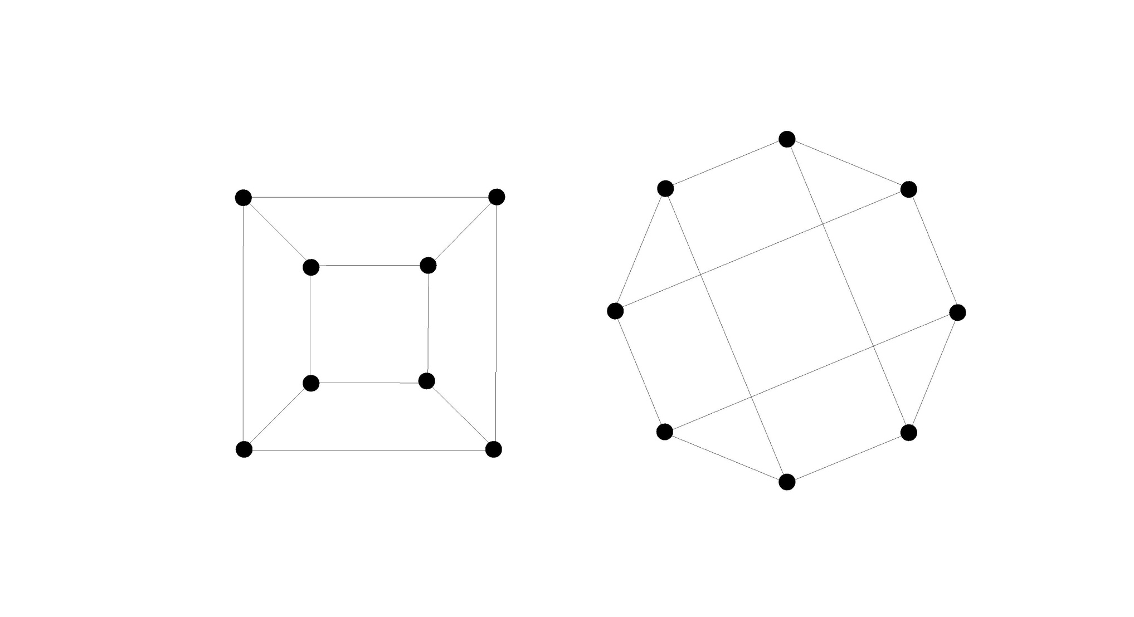
isomorphic graphs

Slide 22
non-isomorphic graphs

Slide 23
Special graphs
cliques (complete graphs): K_{n}
n nodes
all distinct nodes are joined
cocliques (independent sets): K_{n}
n nodes
no edges
complement of a clique
(will define later)

Slide 24
cycles C_{n}
-n nodes on a circle
paths P_{n}
-n nodes on a line
-length is n-1

Slide 25
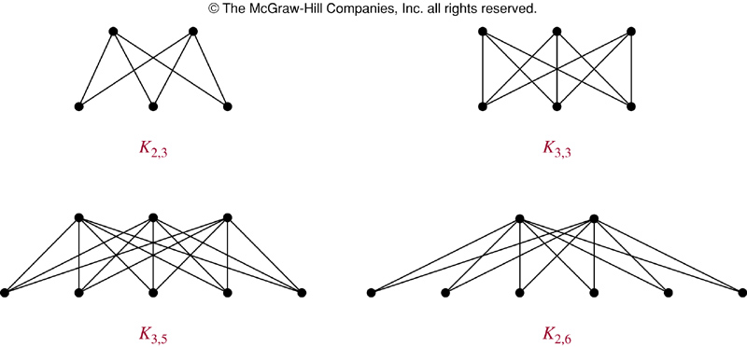
bipartite cliques (bicliques, complete bipartite graphs)
K_{i,j}: a set X of vertices of cardinality i, and one Y of cardinality j, such that all edges are present between X and Y, and these are the only edges

Slide 26
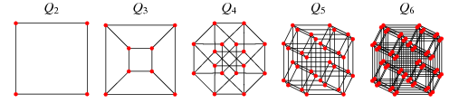
hypercubes Q_{n}
-vertices are n-bit binary strings; two strings adjacent if they differ in exactly one bit

Slide 27
Petersen graph

Slide 28
Connected graphs
a graph is connected if every pair of distinct vertices is joined by at least one path
otherwise, a graph is disconnected
connected components: maximal (with respect to inclusion) connected induced subgraphs

Slide 29
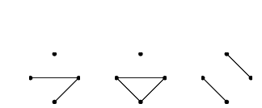
Examples of connected components

Slide 30
Exercise
1.6 What is the maximum number of components a graph of order n can have?
1.7 If each component of G has order 2, then what graph is G isomorphic to?

Slide 31
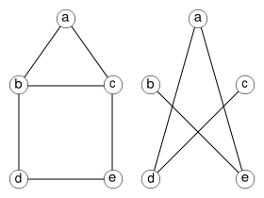
Graph complements
the complement of a graph G, written G,
has the same vertices as G, with two distinct vertices joined if and only they are not joined in G
examples:

Slide 32
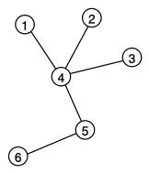
Trees
a graph is a tree if it is connected and contains no cycles (that is, is acyclic)

Slide 33
Theorem 2.1: The following are equivalent
The graph G is a tree.
The graph G is connected and has size exactly |V(G)|-1.
Every pair of vertices in G is connected by a unique path.

Slide 34
Exercise
1.8 Prove that a (finite) tree always has at least two end-vertices.
1.9 What is the tree of order n with the maximum number of leaves?
1.10 What is the tree of order n with the minimum number of leaves?

Slide 35
Girth
the girth of a graph G, written g(G), is the minimum order of a cycle in G
δ(G) is the minimum degree of G, while
Δ(G) is the maximum degree

Slide 36
Distance
d_{G}(x,y) = distance between x and y: the length of a shortest path connecting x and y (∞ otherwise)
the diameter of G, written diam(G), is the maximum of d_{G}(x,y) over all pairs x and y

Slide 37
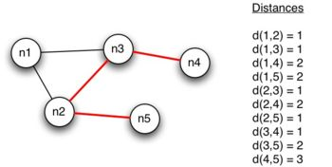

Slide 38
Big-Oh notation
f = O(g) if exists and is finite
f = Ω(g) if g = O(f). We write f = Θ(g) if f =O(g) and g = O(f).
f = o(g) if
f ~ g if

Slide 39
Useful inequalities
If x is a real number, then 1+x ≤ e^{x}.
If 4 ≤ m ≤ n, then
If x = o(1), then log(1+x) ~ x.

