Slide 1
2015 CMS Summer Meeting
Session on Graphs, Designs, and Hypergraphs
A probabilistic version of
the game of Zombies and Survivors
on graphs
Anthony Bonato
Ryerson University

Slide 2
Zombie culture
400+ zombie-themed movies
Walking Dead season 5 finale: 15.8 million viewers
tens of thousands participate in “Zombie Walks” across the world

Slide 7
Zombie horde
up to $\left\lceil n/2\right\rceil$- 2 zombies on an induced path will never capture the survivor

Slide 8
The game

Slide 9
Zombies and Survivors
set of zombies, one survivor
players move at alternate ticks of the clock, from vertex to vertex along edges
zombies choose their initial locations u.a.r.
at each step the zombies move along a shortest path connected to the survivor
if more than one such path, then they choose one u.a.r.
zombies win if one or more can eat the survivor
land on the survivor’s vertex
otherwise, survivor wins
NB: zombies have no strategy!

Slide 10
Zombie number

Slide 11
(B,Mitsche,Perez-Gimenez,Pralat,15+)
s_{k}(G): probability survivor wins if k zombies play, assuming optimal play
s_{k+1} (G) ≤ s_{k} (G) for all k, and s_{k}(G) → 0 as k → ∞
zombie number of G is
z(G) = min{k ≥ c(G): s_{k}(G) ≤ ½}
well-defined
z(G) represents the minimum number of zombies such that the probability that they eat the survivor is > ½
note that c(G) ≤ z(G)
Z(G) = z(G) / c(G): cost of being undead

Slide 12
Zombie epidemics

Slide 13
Zombies vs MTM

Slide 14
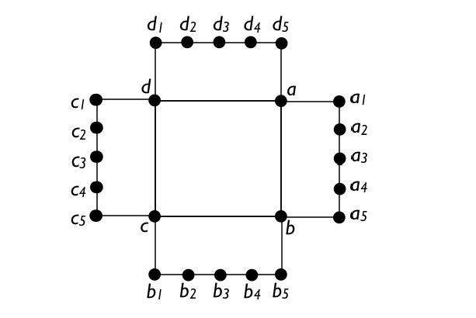
Deterministic Zombies
deterministic version of the game:
(Fitzpatrick, Howell, Messinger,Pike,15+) at the SIAM DM 2014
conference in Minneapolis
in the deterministic version, the zombies choose their location, and can choose their geodesics if more than one
example: where c(G) = 2 < z(G) = 3
results on certain Cartesian products, and bridged graphs

Slide 15
Cop number

Slide 16
c(G): minimum number of cops needed to capture robber, where cops have all strategies available
Meyniel’s Conjecture (85): c(G) = O(n^{1/2}) if G is connected
computing c(G) ≤ k
(Berrarducci, Intrigila, 93), (Hahn,MacGillivray, 06), (B,Chiniforooshan, 09): polynomial time if k is fixed
(Kinnersley,15): EXPTIME-complete, if k not fixed
not know if it is in NP
(Aigner,Fromme,84): c(G) ≤ 3 if G is planar
Schroeder’s conjecture (01): c(G) ≤ g + 3, if g is the genus of G

Slide 17
Z(G) can be large

Slide 18
c(G) = 2
with probability
$${\left(1−\frac{5}{\text{n}}\right)}^{\text{k}}=\exp\left(−\frac{5\text{k}}{\text{n}}+O\left(\frac{\text{k}}{{\text{n}}^{2}}\right)\right)$$
all zombies begin outside the cycle
implies:
$$z\left(\text{G}\right)\sim \frac{\log{2}}{5}\text{n}$$
and so
$$Z\left(\text{G}\right)\sim \frac{\log{2}}{10}\text{n}$$
n-5 leaves
G

Slide 19
Cycles

Slide 20
Zombie number of cycles
Theorem (BMPGP,15+)
If n ≥ 27, then z(C_{n}) = 4, so Z(C_{n}) = 2.

Slide 21
Sketch of proof
survivor wins iff the zombies are on a subpath of order at most $\left\lceil \text{n}/2\right\rceil$- 2
overcount these configurations:
distinguishing two zombies one at each end of the subpath
k(k-1) ways to select the two zombies; n choices for position of the path
two zombies start in right place with probability (1/n)²
remaining zombies on subpath, with probability (r/n)^{k-2}

Slide 22
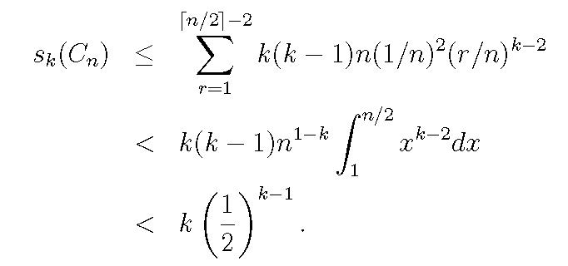
Sketch of proof
hence,
k = 4 gives s_{k}(C_{n}) ≤ ½
lower bound analogous

Slide 23
Projective planes

Slide 24
finite projective plane P:
two lines meet in a unique point
two points determine a unique line
exist 4 points, no line contains more than two of them
q²+q+1 points; each line (point) contains (is incident with) q+1 points (lines)
incidence graph (IG) of P:
bipartite graph G(P) with red nodes the points of P and blue nodes the lines of P
a point is joined to a line if it is on that line

Slide 25
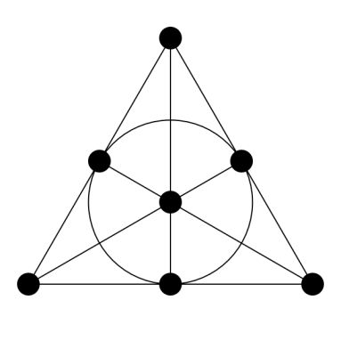
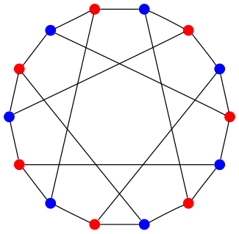
Example
Fano plane
Heawood graph

Slide 26
Cop number of planes
IG of projective planes: girth 6, (q+1)-regular, so have cop number ≥ q+1
order 2(q²+q+1)
(Prałat,10): cop number = q+1

Slide 27
Zombies on planes
Theorem (BMPGP,15+)
For large q,
$z\left(G_{q}\right)=2q+θ(\sqrt{q}$ ).
Hence, Z($G_{q}$) = 2.

Slide 28
Hypercubes

Slide 29
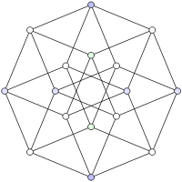
(Maamoun,Meyniel,87) $c(Q_{n})=\left\lceil \frac{n+1}{2}\right\rceil$
Theorem (BMPGP,15+)
For large n,
$z\left(Q_{n}\right)=\frac{2n}{3}+θ(\sqrt{n}$ ).
Hence, Z($G_{q}$) = 4/3.

Slide 30
Sketch of proof of lower bound
show a.a.s. survivor can escape $k=\frac{2n}{3}+ω\sqrt{n}$ zombies
vertices: binary bit strings
Chernoff’s bound: $\frac{k}{2}+O\sqrt{ωn}=\frac{n}{3}−\left(1+o\left(1\right)\right)\frac{ω\sqrt{n}}{2}<n/3$ zombies begin with an even number of ones in their binary string
this holds throughout the game, as zombies always move
the survivor, independently, always has an even distance to less than n/3 zombies, and an odd distance to less than n/3 zombies

Slide 31
Sketch of proof of upper bound
survivor strategy: pick an arbitrary vertex distance at least 2 from all the zombies
note that there are at most k(n+2) < 2^{n} vertices at distance at most 1 from some zombie
if after the zombie’s move, no zombie is distance 1 to the survivor, then the survivor stands still
otherwise, survivor must move to a safe vertex
each zombie distance 1 (< n/3) forbids a coordinate, and each zombie at distance 2 (< n/3) forbids two coordinates
so less than n coordinates forbidden, so survivor can move

Slide 32
Grids

Slide 33
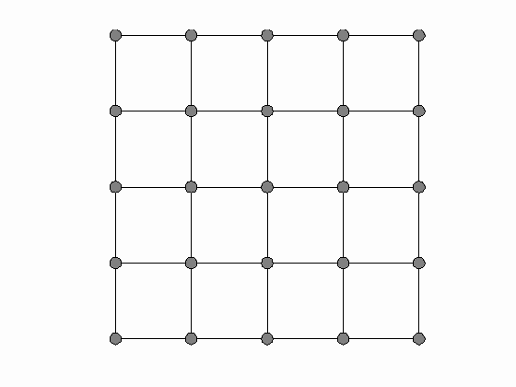
Cartesian grids
(Tosic, 87) c(G H) ≤ c(G) + c(H)
Theorem (BMPGP,15+)
For n ≥ 2, z(P_{n} P_{n}) = 2, so Z(P_{n} P_{n}) =1.

Slide 34
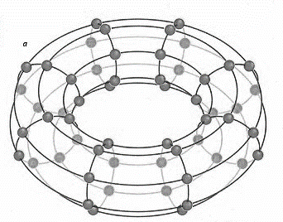
Toroidal grids
T_{n} = C_{n} C_{n}
(Neufeld, 90): c(T_{n}) = 3
Theorem (BMPGP,15+)
Let ω = ω(n) be a function tending to infinity with n.
Then a.a.s.
$z\left(T_{n}\right)≥\sqrt{n}$ / (ω log n).

Slide 35
Necromancers

Slide 36
Necromancers and Survivors
set of j necromancers (i.e. cops, who can access all strategies) and k zombies play vs survivor
(j,k)-necro-win: bad guys win with probability > 1/2
Theorem (B, Perez-Gimenez, Reineger,15+)
For large m and n, toroidal grids C_{m} C_{n} are (2,1)-necro-win.
For m and n are co-prime, C_{m} C_{n} is (1,2) -necro-win.

Slide 37
Problems

Slide 38
zombie number of toroidal grid
upper bounds?
sub-quadratic upper bound?
other grids? graph products?
Necromancer + k zombies: how large must k be to ensure win on square toroidal grids?
random graphs? G(n,p), G(n,r), random regular, …
deterministic version: can z(G) – c(G) tend to ∞?

Slide 39
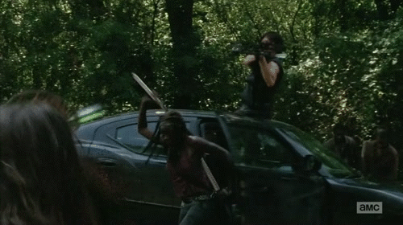
survivor fights back?
(Finbow, Gordinowicz, Haidar, Kinnersley, Mitsche, Pralat, Stacho, 13): The robber strikes back In: Proceedings of ICC3, 2013.

